Slide 1
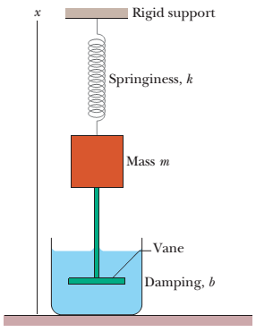





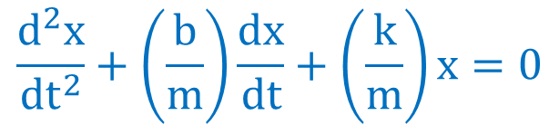
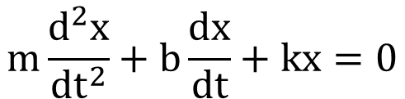

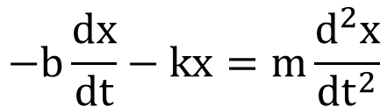

Lecture 16: Damped Simple Harmonic Motion
The liquid exerts a damping force, $F_{d}$ $∝$ velocity, $ν$ of vane and liquid
[if vane moves slowly]
$$F_{d}∝ν$$
[Let rod and vane = massless]
$$F_{d}=− bν$$
[b = damping constant]
$$F_{s}=− k x$$
Newton’s second law for components along the x axis
$$F_{net, x}=ma_{x}$$
$$F_{d}+F_{s}=ma$$
F_{s}
$$−bν−kx=ma$$
x
$$−b\frac{ⅆx}{ⅆt}−kx=m\frac{ⅆ^{2}x}{ⅆt^{2}}$$
rod
F_{d}
$$m\frac{ⅆ^{2}x}{ⅆt^{2}}+b\frac{ⅆx}{ⅆt}+kx=0$$
v
$$\frac{ⅆ^{2}x}{ⅆt^{2}}+\left(\frac{b}{m}\right)\frac{ⅆx}{ⅆt}+\left(\frac{k}{m}\right)x=0$$

Slide 2
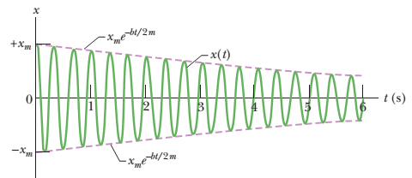

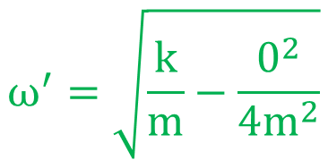

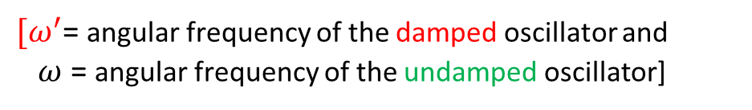
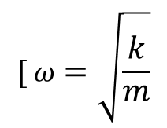

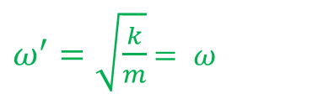
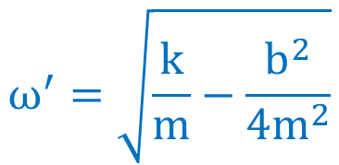
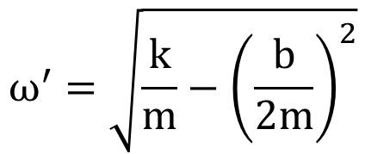

The displacement of damped simple harmonic oscillator:
$$x\left(t\right)=\left[x_{m}ⅇ^{−\left(\frac{b}{2m}\right)t}\right]\cos\left(ω^{′}t+φ\right)$$
The amplitude, $x_{m}ⅇ^{−\left(\frac{b}{2m}\right)t}$decreases exponentially with time.
$$ω^{′}=\sqrt{ω2−γ^{2}}$$
${[ω}^{′}$= angular frequency of the damped oscillator and
$ω$= angular frequency of the undamped oscillator]
$$ω^{′}=\sqrt{\frac{k}{m}−{\left(\frac{b}{2m}\right)}^{2}}$$
$$[ ω=\sqrt{\frac{k}{m}}$$
$γ=\frac{b}{2m}$]
$$ω^{′}=\sqrt{\frac{k}{m}−\frac{b^{2}}{4m^{2}}}$$
If there is no damping, b = 0 :
$$ω^{′}=\sqrt{\frac{k}{m}−\frac{0^{2}}{4m^{2}}}$$
$ω^{′}=\sqrt{\frac{k}{m}}$ $= ω$
[angular frequency of an undamped oscillator]
$$The displacement of undamped simple harmonic oscillator becomes x\left(t\right)=x_{m}\cos\left(ωt+φ\right).$$
For the undamped simple harmonic motion, the amplitude x_{m} does not change with time.

Slide 3
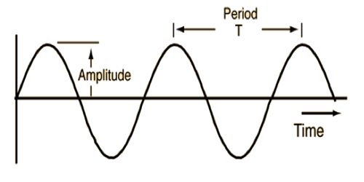
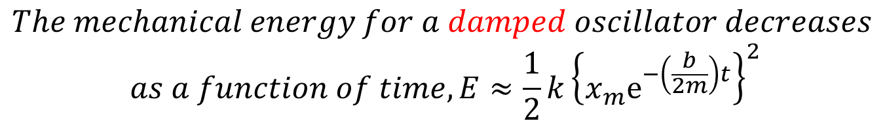
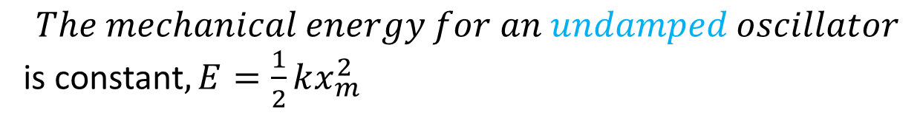
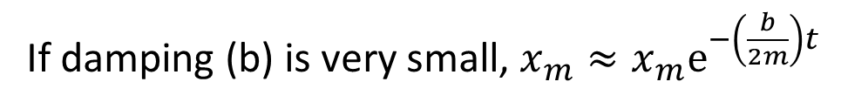

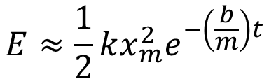
Damped $mechanical energy:$
$$The mechanical energy for an undamped oscillator$$
is constant$, E=\frac{1}{2}kx_{m}^{2}$
If damping (b) is very small, ${x_{m}≈x}_{m}ⅇ^{−\left(\frac{b}{2m}\right)t}$
$$The mechanical energy for a damped oscillator decreases$$
$$as a function of time, E≈\frac{1}{2}k{\left\{x_{m}ⅇ^{−\left(\frac{b}{2m}\right)t}\right\}}^{2}$$
$$E≈\frac{1}{2}kx_{m}^{2}ⅇ^{−\left(\frac{b}{m}\right)t}$$

Slide 4

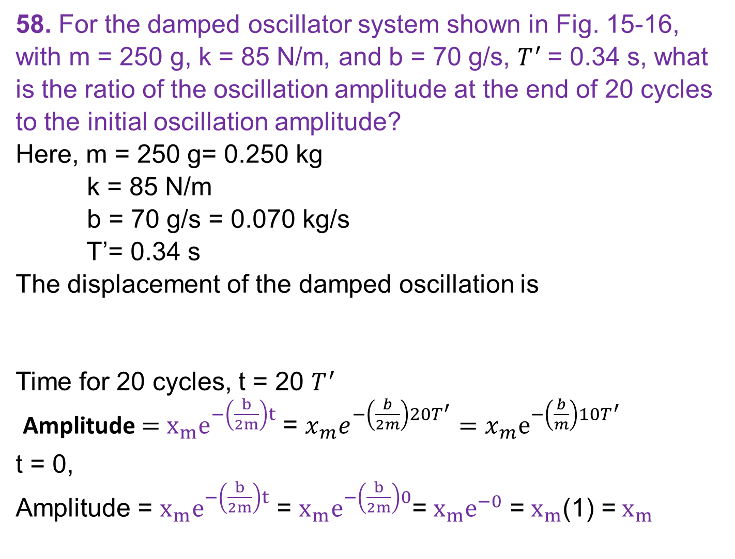
58. For the damped oscillator system shown in Fig. 15-16, with m = 250 g, k = 85 N/m, and b = 70 g/s, $T^{′}$= 0.34 s, what is the ratio of the oscillation amplitude at the end of 20 cycles to the initial oscillation amplitude?
Here, m = 250 g= 0.250 kg
k = 85 N/m
b = 70 g/s = 0.070 kg/s
T’= 0.34 s
The displacement of the damped oscillation is
Time for 20 cycles, t = 20 $T^{′}$
Amplitude $=$ $x_{m}ⅇ^{−\left(\frac{b}{2m}\right)t}$ = $x_{m}ⅇ^{−\left(\frac{b}{2m}\right)20T^{′}}=x_{m}ⅇ^{−\left(\frac{b}{m}\right)10T^{′}}$
t = 0,
Amplitude = $x_{m}ⅇ^{−\left(\frac{b}{2m}\right)t}$ = $x_{m}ⅇ^{−\left(\frac{b}{2m}\right)0}$= $x_{m}ⅇ^{−0}$ = $x_{m}$(1) = $x_{m}$
$$x\left(t\right)=\left[x_{m}ⅇ^{−\left(\frac{b}{2m}\right)t}\right]\cos\left(ω^{′}t+φ\right)$$

Slide 5

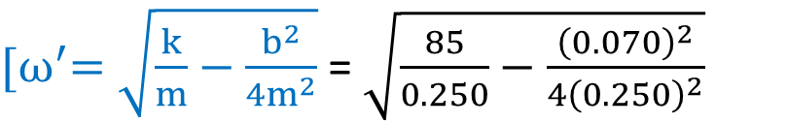
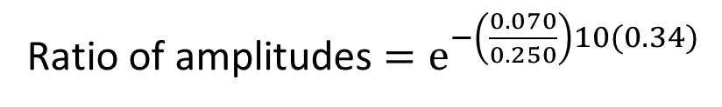



Ratio of amplitudes $=\frac{x_{m}ⅇ^{−\left(\frac{b}{m}\right)10T^{′}}}{x_{m}}=ⅇ^{−\left(\frac{b}{m}\right)10T^{′}}$
${[ω}^{′}=\sqrt{\frac{k}{m}−\frac{b^{2}}{4m^{2}}}$ = $\sqrt{\frac{85}{0.250}−\frac{{\left(0.070\right)}^{2}}{4{\left(0.250\right)}^{2}}}$
F_{s}
$$ω^{′}=18.44 rad/s$$
x
$T^{′}=\frac{2π}{ω^{′}}$ = 0.34 s]
rod
F_{d}
Ratio of amplitudes $=ⅇ^{−\left(\frac{0.070}{0.250}\right)10(0.34)}$
v
$=ⅇ^{−0.952}=$ 0.39

Slide 6
60.The suspension system of a 2000 kg automobile “sags”10 cm when the chassis is placed on it. Also, the oscillation amplitude decreases by 50% each cycle. Estimate the values of (a) the spring constant k and (b) the damping constant b for the spring and shock absorber system of one wheel, assuming each wheel supports 500 kg.
(a) Hooke’s law, F = kx [magnitude only]
mg = kx
One quarter of the vehicle mass, m = 2000/4 kg = 500 kg
x = 10 cm = 0.10 m
k = mg/x = 500(9.8)/0.10 = 49000 N/m
[The displacement is downward and the spring force is upward]

Slide 7

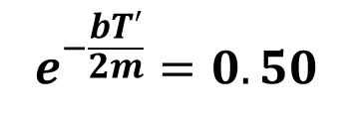
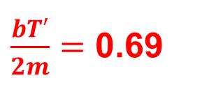
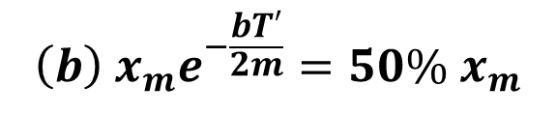
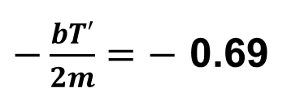
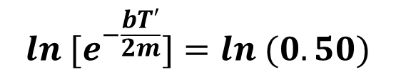

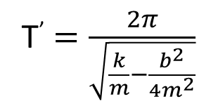
For one cycle, t = $T′$ s
$${\left(b\right) x}_{m}e^{−\frac{bT′}{2m}}=50\%{ x}_{m}$$
$$e^{−\frac{bT′}{2m}}=0.50$$
$${ln [e}^{−\frac{bT′}{2m}}]=ln (0.50)$$
$−\frac{bT′}{2m}=−$ 0.69
$\frac{bT′}{2m}=$ 0.69
Time period of a damped SHM, T’ = $\frac{2π}{ω^{′}}$
T’ $=\frac{2π}{\sqrt{\frac{k}{m}−\frac{b^{2}}{4m^{2}}}}$

Slide 8

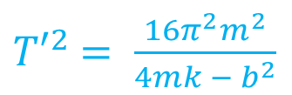
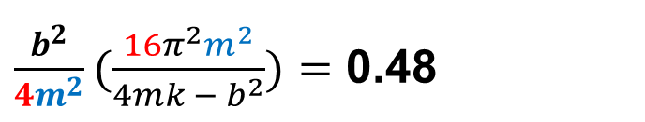
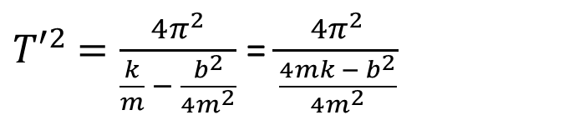
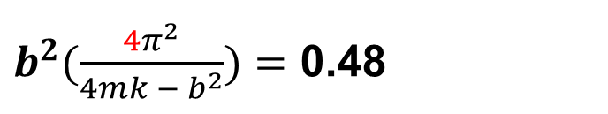
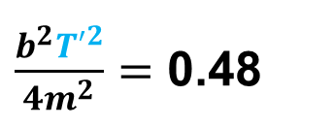
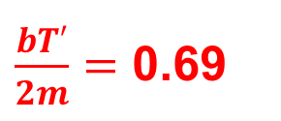
${T′}^{2}$ $=\frac{4π^{2}}{\frac{k}{m} − \frac{b^{2}}{{4m}^{2}}}$ = $\frac{4π^{2}}{\frac{{4mk − b}^{2}}{{4m}^{2}}}$
${T′}^{2}$ $= \frac{{16π}^{2}m^{2}}{{4mk − b}^{2}}$
$\frac{bT′}{2m}=$ 0.69
$\frac{b^{2}{T′}^{2}}{4m^{2}}=$ 0.48
$\frac{b^{2}}{4m^{2}}(\frac{{16π}^{2}m^{2}}{{4mk − b}^{2}})=$ 0.48
$b^{2}(\frac{{4π}^{2}}{{4mk − b}^{2}})=$ 0.48
$${4π^{2}b^{2}=0.48(4mk − b}^{2})$$

Slide 9
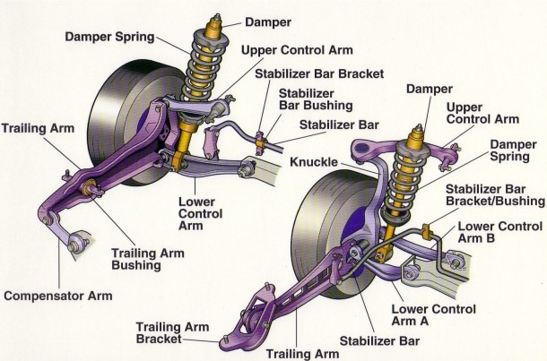

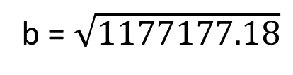
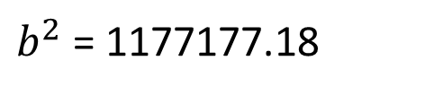


$${4π^{2}b^{2}=1.92mk −0.48b}^{2}$$
$$4π^{2}b^{2}+0.48b^{2}=1.92mk$$
$$b^{2}(4π^{2}+0.48)=1.92(500)(49000)$$
${39.96b}^{2}$= 47040000
$b^{2}$= 1177177.18
b = $\sqrt{1177177.18}$
b = 1084.98 kg/s

Slide 10
Additional problem:
Sample problem 15:06, page: 432

